Slide 1
Roadmap 2013-2015
Ericsson Catalog Manager
Notes:
January 2014
Ericsson Catalog Manager Roadmap 2013-2015
224 01-FGB 101 0285 Uen, Rev A

Slide 2
Disclaimer
Ericsson (the Company) does not guarantee that the assumptions underlying any forward-looking statements are free from errors nor do they accept any responsibility for the future accuracy of the opinions expressed in this document or the actual occurrence of the forecasted developments.
Neither the delivery of this document nor any further discussions of the Company with any of the recipients shall, under any circumstances, create any implication that there has been no change in the affairs of the Company since such date. The Company is under no obligation to update or keep current the information contained in this material or in the presentation to which they relate and any opinions expressed in them are subject to change without notice. No representation or warranty (express or implied) is made as to, and no reliance should be placed on, the fairness, accuracy or completeness of the information contained herein and, accordingly, that neither the Company nor any of such person’s officers, directors or employees accepts any liability whatsoever arising directly or indirectly from the use of this document.
Notes:
Ericsson Catalog Manager Roadmap 2013-2015
January 2014
224 01-FGB 101 0285 Uen, Rev A

Slide 3






Portfolio
Ericsson Catalog Manager
Notes:
January 2014
Ericsson Catalog Manager Roadmap 2013-2015
224 01-FGB 101 0285 Uen, Rev A

Slide 4
Release status Conventions
Released | Released Product or Feature. Products available for unrestricted global delivery (GA status) are defined as released products. There might be more than one release in a product line available on the market.
Ready for Contract | Products or features are ready for the customer contracts. Normally only minor changes are possible before the release of the product.
Indicative | Future products or features where release intent has been defined and development has started for some objects. Release scope and the GA date might change.
Candidate | Potential products or features where implementation has not started. Candidates for scope are suggested. Release scope and functions as well as the GA date might change.
Notes:
IMS Roadmap Presentation IMS Roadmap Presentation IMS Roadmap Presentation IMS Roadmap Presentation
11/08/262011-11-28
© Ericsson AB 2005-2010 © Ericsson AB 2005-2010 Ericsson AB 2005-2010 © Ericsson AB 2005-2010
IMS Roadmap Presentation IMS Roadmap Presentation IMS Roadmap Presentation
11/08/262011-11-28
© Ericsson AB 2005-2010 Ericsson AB 2005-2010 © Ericsson AB 2005-2010
IMS Roadmap Presentation IMS Roadmap Presentation
Ericsson AB 2005-2010 © Ericsson AB 2005-2010
IMS Roadmap Presentation
2011-11-28
© Ericsson AB 2005-2010
Ericsson Catalog Manager Roadmap 2013-2015
224 01-FGB 101 0285 Uen, Rev A
January 2014

Slide 5

Ericsson Catalog Manager
14B
15A
16A
Towards a Suite
An Integrated Suite
The Agile Suite
Role Based User Interface
  Product Mktg / Mgmt
  Billing
User Experience
  Drag and Drop
  PLM management
Functionality
  Actions
  Dates
Reporting
    TMF GB935 Benchmarking Metrics
Role Based User Interface
  Policy
  Fulfillment
  Orchestration
User Experience
  Continued enhancements
Functionality
  Improved cost / uptake tracking
Integration
  B2B Catalog Exchange
  Publishing between instances
SaaS Offering
  Shared instance across many clients
Role Based User Interface
  Wizards
Templates
  Library of best practice modeled services
Integration
  Standard models for key third-party product vendors
Listed are the key focus segments for the upcoming major releases only. All releases also include regular core product and module optimizations, enhancements and repairs.
14B
15A
16A
Q2
Q3
Q4
Q1
Q2
Q3
Q4
Q1
Q2
Q3
Q4
Q1
Q2
Q3
Q4
Q1
GA
2012
2013
2014
2015
Validated
Indicative
Candidate
Notes:
January 2014
Ericsson Catalog Manager Roadmap 2013-2015
224 01-FGB 101 0285 Uen, Rev A

Slide 6
Ericsson Catalog Manager
14B Selected Details
Role-based User Interface
(details follow)
Drag-and-Drop support and incorporation into catalog modelling
Expand use of Orchestration Framework and expose full PLM workflow management
Provide ability to define actions on basket, workflow, etc. that occur on specific actions, via the catalog
Expose pricing logic for customization
TMF GB935 Benchmarking Metrics (details follow)
Improve Basket implementation for performance
Expand basket and basket charge APIs
Improve catalog import/export functionality
Improve product lifecycle date management in the catalog
Notes:
January 2014
Ericsson Catalog Manager Roadmap 2013-2015
224 01-FGB 101 0285 Uen, Rev A

Slide 7
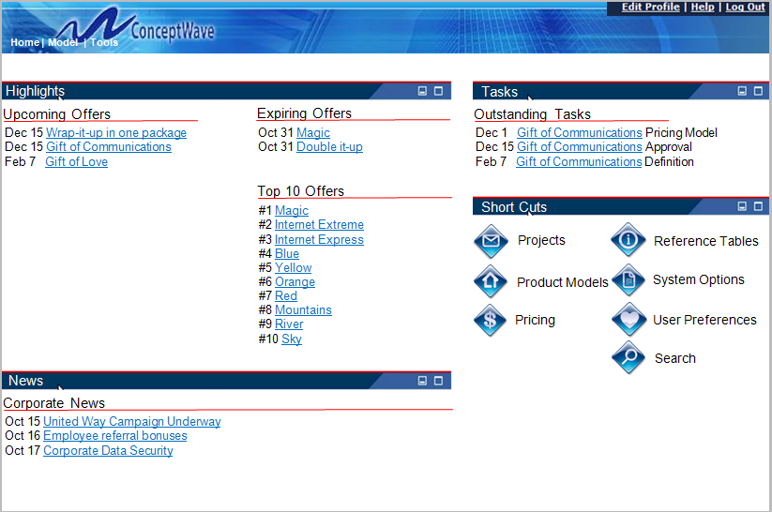
Role-Based User Interface for PLM
  Leverage Velocity Studio to redesign the
  User Interface
Features
  Role-based views
  Dashboard
  More information presented on one page
  One-click navigation
  Reduced pop-ups
  Editable lists
  PLM focused through-out
Result
  More intuitive user interface better suited to non-technical user
Notes:
Ericsson Catalog Manager Roadmap 2013-2015
224 01-FGB 101 0285 Uen, Rev A
January 2014

Slide 8
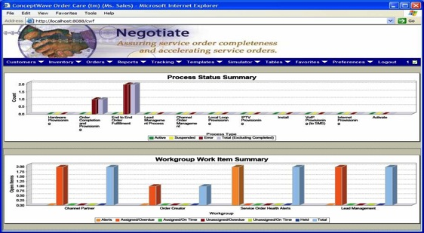
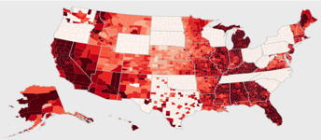
Product Analytics
Implementation of a deep set of pre-configured reports
Implementation of TMF’s GBF935 Reports (for Catalog domain)
Richer reporting objects that permit interaction, i.e. drill-down via the generated graphs
Reporting management module
  Report Subscription, scheduling,
  distribution and archiving
  Online retrieval
  Electronic PDF and Excel distribution
Notes:
January 2014
Ericsson Catalog Manager Roadmap 2013-2015
224 01-FGB 101 0285 Uen, Rev A

Slide 9
COMMON CHARACTERISTICS
USER EXPERIENCE
Common look and feel
Single sign-on
Unified reporting
ARCHITECTURE
Common information architecture
Pre-integrated products
Well-defined customization points
PLATFORM
Common execution environment
Common monitoring and configuration
Common licensing framework
Cloud ready
COMMERCIALS
Common licensing framework
Harmonized release management
Notes:
‘In defining OSS suites we are defining a blue print for the way our products and third-party products should interact to deliver end-to-end business process value. In our blue print different commercial models will be important in different integrations. The suite will therefore provide a range of integration models from product integration through to best practice and market positioning based on this commercial context: Full product integration between products where volume of market makes sense; Standards integration where products are expected to interact with many competitive products; Market positioning/best practice where volume of market is small.’
January 2014
Ericsson Catalog Manager Roadmap 2013-2015
224 01-FGB 101 0285 Uen, Rev A

Slide 10
Common Characteristics
14B
15A
16A
Towards a Suite
An Integrated Suite
The Agile Suite
User Experience
  Basic branding
Information Architecture
  Catalog
Execution Environment
  Aligned platform versions
Cloud Ready
  Hosted in cloud
Release Management
  Numbering
  Schedule
User Experience
  Stylesheet
Information Architecture
  Order Management
  Customer
Execution Environment
  Common authentication, logging, deployment, configuration
Cloud Ready
  Scaling in cloud
Licensing Model
  Packaging / metrics
User Experience
  Common UI framework
Information Architecture
  Full
Execution Environment
  Full
SaaS Ready
  Shared instances
  Usage metrics / licensing
Listed are the key focus segments for the upcoming major releases only. All releases also include regular core product and module optimizations, enhancements and repairs.
14B
15A
16A
Q2
Q3
Q4
Q1
Q2
Q3
Q4
Q1
Q2
Q3
Q4
Q1
Q2
Q3
Q4
Q1
GA
2012
2013
2014
2015
Validated
Indicative
Candidate
Notes:
January 2014
Ericsson Catalog Manager Roadmap 2013-2015
224 01-FGB 101 0285 Uen, Rev A

Slide 11
Suite Integration
Ericsson Catalog Manager
Notes:
January 2014
Ericsson Catalog Manager Roadmap 2013-2015
224 01-FGB 101 0285 Uen, Rev A

Slide 12
Integration Roadmap - 2013
Idea-to-Implementation
Lead-to-Cash
(Full Stack View)
Ericsson
Telecom CRM
Self-Care
Ericsson Catalog Manager
Ericsson Order Care
Service-Aware
Policy Controller
Single Point of Configuration
Ericsson
Multi
Mediation
Ericsson CBiO
Ericsson
Multi
Activation
Ericsson CBiO
Notes:
January 2014
Ericsson Catalog Manager Roadmap 2013-2015
224 01-FGB 101 0285 Uen, Rev A

Slide 13
Integration Roadmap - 2014
Idea-to-Implementation
Lead-to-Cash
(Full Stack View)
Ericsson
Telecom CRM
Self-Care
Ericsson
Telecom CRM
Self-Care
Ericsson Catalog Manager
Ericsson Catalog Manager
Ericsson Order Care
Ericsson
Multi
Mediation
Ericsson Order Care
Ericsson Service Enablement
Service-Aware
Policy Controller
Single Point of Configuration
Ericsson Service Enablement
Service-Aware
Policy Controller
Ericsson
Multi
Mediation
Ericsson CBiO
Ericsson
Multi
Activation
Ericsson CBiO
Ericsson
Multi
Activation
Notes:
January 2014
Ericsson Catalog Manager Roadmap 2013-2015
224 01-FGB 101 0285 Uen, Rev A

Slide 14

Notes:
January 2014
Ericsson Catalog Manager Roadmap 2013-2015
224 01-FGB 101 0285 Uen, Rev A

